Slide 1
Target Corporation
Name
Institution
Course
Instructor
Date

Slide 2
Sources of cash
Operations
  Proceeds from disposal of property and equipment
  Other investments
Investment activities
  Additions to long-term debt
  Stock option exercises
Financing activities
  Discontinued operations
Notes:
There are various sources of cash for Target Corporation according to their statement of cash flows. These include operations, investment activities as well as financing activities. The sources of cash identified include proceeds from disposal of property and equipment as well as other investments. Investment activities are also a source of cash including addition of long-term debt as well as stock option exercises. The only source of income from financing activities includes funds from discontinued activities.

Slide 3
Uses of Cash
Operations
  Expenditures for property and equipment
Investment activities
  Reductions of long-term debt
  Dividends paid
  Repurchase of stock
No financing activities
Notes:
Target corporation uses its cash in operations and investment activities. The company does not have any financing activities. Uses of cash in operations include expenditures on property and equipment. Investment activities include reductions of long-term debt, dividends paid, repurchase of stock.

Slide 4
Net income vs. Cash-Flow
Cash Flow
  It is the cash generated by Target in a given period.
  It includes the difference between cash inflow and cash outflow during the given period.
Net income
  Includes the earnings of the company in a given period.
  It includes the revenue received less the expenditures of the organization.
Notes:
Cash Flow
It is the cash generated by Target in a given period.
It includes the difference between cash inflow and cash outflow during the given period.
Net income
Includes the earnings of the company in a given period.
It includes the revenue received less the expenditures of the organization.

Slide 5
Financial strengths
Highly solvency rate
  The firm has a high equity to asset ration
Profitability of operations
  The firm has a high revenue generation from its operations
  The firm has minimized its operations expenses to maximize profit.
Notes:
Highly solvency rate
The firm has a high equity to asset ration
Profitability of operations
The firm has a high revenue generation from its operations
The firm has minimized its operations expenses to maximize profit.

Slide 6
Financial Weaknesses
High-level of long-term debt reduces the cash flow in the business
The cash generated from investment activities is lower than organizational expenditure on investment
The company has low financing activities which has reduced chances of revenue maximization.
Notes:
High-level of long-term debt reduces the cash flow in the business
The cash generated from investment activities is lower than organizational expenditure on investment
The company has low financing activities which has reduced chances of revenue maximization.

Slide 7
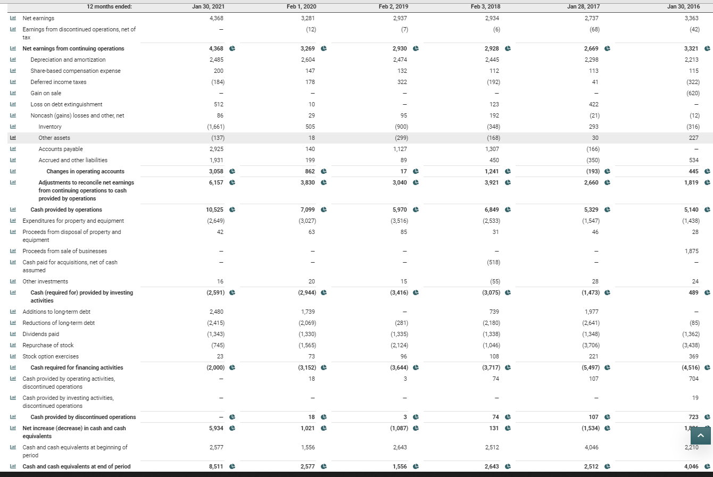
Screenshot

